Slide 1
Databases 4
Ashley Cahill
ashley.cahill@tus.ie

Slide 2
Topics
JDBC (Java Database Connectivity)
JDBC Architecture
Using JDBC
ResultSet Object
PreparedStatement
SQL Injection Attacks

Slide 3
JDBC
JDBC is an API (Application Programming Interface)
JDBC is used for accessing databases from Java applications
Information is transferred from relations to objects and vice-versa.

Slide 4
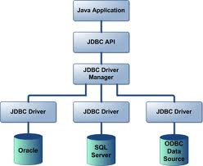
JDBC Architecture

Slide 5

JDBC Architecture
Java code calls JDBC library
JDBC loads a driver
The driver talks to a particular DBMS
An application can work with several DBMS by using corresponding drivers

Slide 6
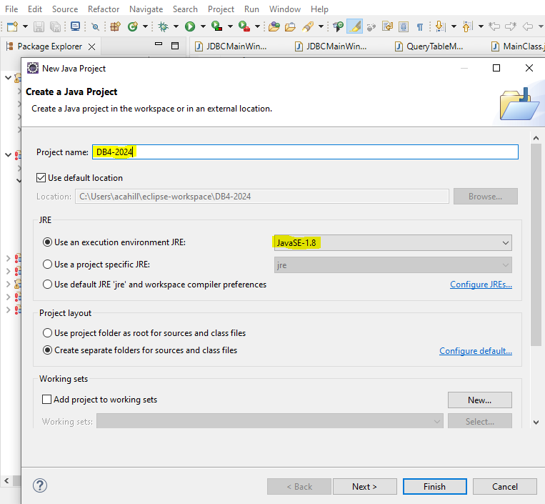
Eclipse Drivers
Create a new Java Project in Eclipse
File -> New -> Java Project
Give the project a name
You can leave the exe env to JavaSE-1.8

Slide 7

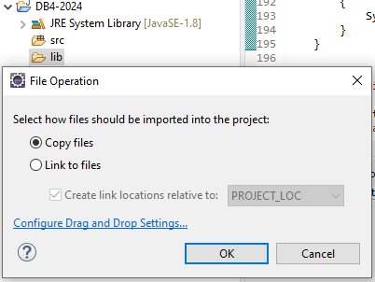

Eclipse Drivers
From the Package Explorer…
Right click on your Project
Make a new folder called ‘lib’ in your project
Download “mysql-connector.jar” from Moodle
Copy the mysql-connector.jar file into the lib folder
You can drag and drop in Eclipse

Slide 8
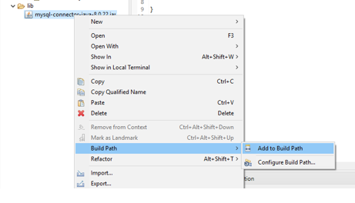
Eclipse Drivers
Right click on JAR
Build Path
Add to Build Path

Slide 9
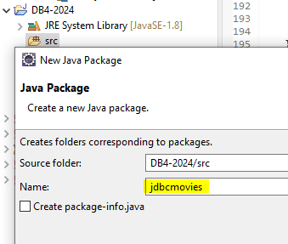
Eclipse Drivers
Right click on src folder
New -> Package
jdbcmovies

Slide 10
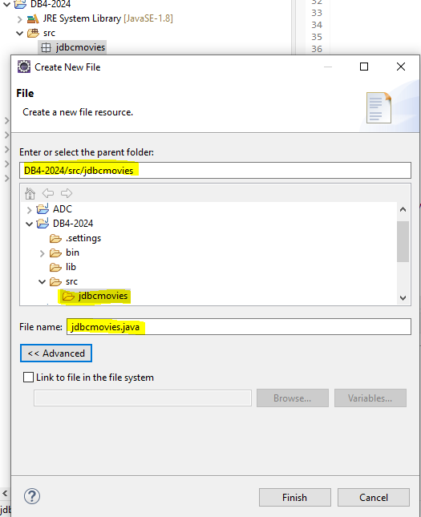
Eclipse Drivers
Right click on the new Package
New -> File
Copy the contents of the jdbcmovies.java file on Moodle into this new file

Slide 11
JDBC – Movies Table
Using the SQL file on Moodle
Create the Movies Database and table
Moviename | Producer | Releasedate
Movie 1 | Producer 1 | 2024-01-01
Movie 2 | Producer 2 | 2024-01-01
Movie 3 | Producer 3 | 2024-04-03

Slide 12
7 Steps For Using JDBC
Load the Driver
Define the connection URL
Establish the connection
Create a Statement object
Execute a query using the Statement
Process the result
Close the connection

Slide 13
1. Loading the Driver
Class.forName(“com.mysql.cj.jdbc.Driver ”);
Class.forName loads the given class dynamically
When the driver is loaded, it automatically creates an instance of itself, registers this instance within DriverManager
MySQL JDBC driver can be downloaded from
http://www.mysql.com/products/connector/
We will be using: JDBC Driver for MySQL (Connector/J)
This driver will be on Moodle

Slide 14
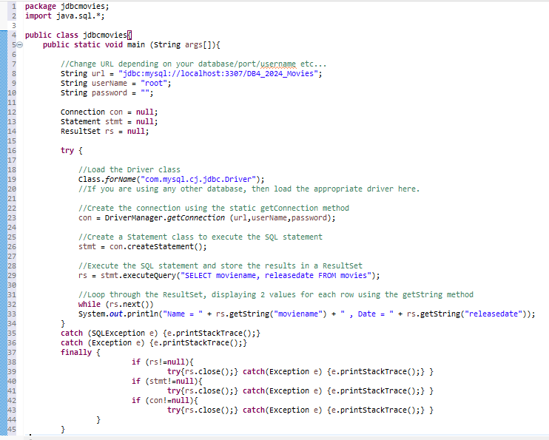

Slide 15
2. Define the Connection URL
Every database is identified by a URL
The username, password and DB name are specified
localhost – we assume the DB is located locally
Remote connections are possible using the IP address of the DBMS server
The default port for MySQL is 3306
May be changed to 3307 if 3306 blocked in Labs

Slide 17
3. Establish The Connection
Connection con =
DriverManager.getConnection(url+dbName, userName, password);
Given a URL, DriverManager looks for the driver that can talk to the corresponding database

Slide 19
4. Create a Statement Object
We use Statement objects in order to
Query the DB
Update the DB (insert, update, create, drop, …)
executeQuery returns a ResultSet object representing the query result (discussed later…)

Slide 21
5. Execute a Query
executeQuery returns a ResultSet object representing the query result (discussed later…)

Slide 23
6. Process The Results
We will discuss ResultSet in a while…

Slide 25
7. Close the Connection
Close Connections, Statements, and Result Sets
con.close();
stmt.close();
rs.close()

Slide 27
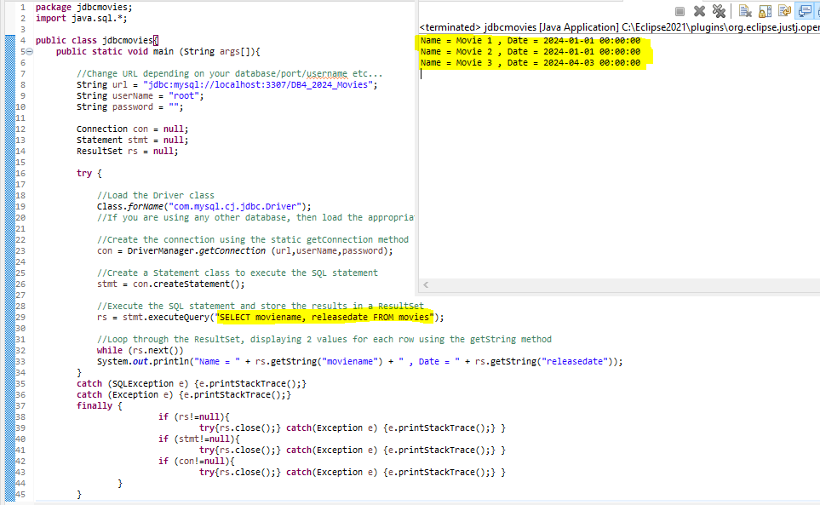
Right click in code
Run As … Java Application

Slide 28
ResultSet
ResultSet objects provide access to the tables generated as results of executing Statement queries.
Only one ResultSet per Statement can be open at a given time
The table rows are retrieved in sequence:
A ResultSet maintains a cursor pointing to its current row.
next() moves the cursor to the next row

Slide 29
ResultSet Methods
boolean next()
Activates the next row
First call to next() activates the first row
Returns false if there are no more rows
Not all of the next calls actually involve the DB
void close()
Disposes of the ResultSet
Allows to re-use the Statement that created it
Automatically called by most Statement methods

Slide 30
ResultSet Methods
Type getType(int columnIndex)
Returns the given field as the given type
Indices start at 1 and not 0
Type getType(String columnName)
Same, but uses name of field
int findColumn(String columnName)
Looks up column index given column name

Slide 31
Timeout
Use setQueryTimeOut(int seconds) of Statement to set a timeout for the driver to wait for a query to be completed.
If the operation is not completed in the given time, an SQLException is thrown

Slide 32
Database Time
Times in SQL are notoriously non-standard
Java defines three classes to help
java.sql.Date
year, month, day
java.sql.Time
hours, minutes, seconds
java.sql.Timestamp
year, month, day, hours, minutes, seconds, nanoseconds
Usually use this one

Slide 33
Moving the Cursor Position Between Rows in the ResultSet
next()
getRow()
first()
last()

Slide 34
ResultSet – next()
Initially the cursor is positioned before the first row.
The next method moves the cursor to the next row, and because it returns false when there are no more rows in the ResultSet object, it can be used in a while loop to iterate through the result set.
while (rs.next()) System.out.println(“…….”);
When rs.next() is false the while loop terminates

Slide 35
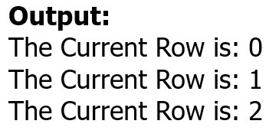
Moving Between Rows in the ResultSet
The current row in the result set can be identified using getRow()
Move to the next row in the result set using next()
System.out.println("The Current Row is: "+rs.getRow());
rs.next();
System.out.println("The Current Row is: "+rs.getRow());
rs.next();
System.out.println("The Current Row is: "+rs.getRow());
rs.next();

Slide 36
ResultSet – first()/last()
public boolean first() throws SQLException
Moves the cursor to the first row in this ResultSet object.
public boolean last() throws SQLException
Moves the cursor to the last row in this ResultSet object.
Returns:
true if the cursor is on a valid row
false if result set is empty

Slide 37
ResultSet – Extracting Data From a Row
getString(int columnIndex)
getString(String columnName)
findColumn(String columnName)

Slide 38
ResultSet
The ResultSet interface provides getter methods (getString, getBoolean, getLong, etc) for retrieving column values from the current row.
Values can be retrieved using either the index number of the column or the name of the column.
Columns are numbered from 1.
For the getter methods, a JDBC driver attempts to convert the underlying data to the Java type specified in the getter method and returns a suitable Java value

Slide 39
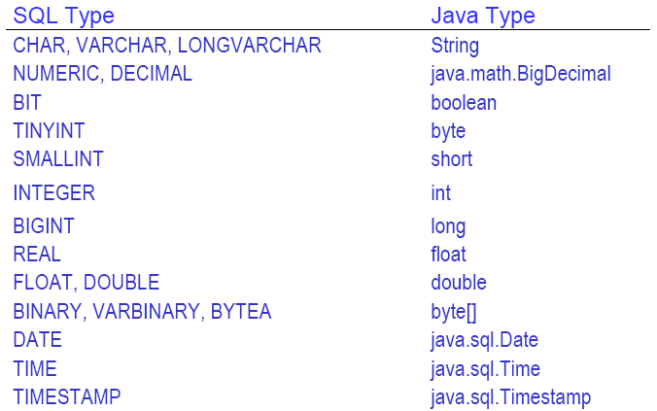
Mapping Java Types to SQL Types

Slide 40
ResultSet – getString() Using a Column Index
public String getString(int columnIndex) throws SQLException
Retrieves the value of the designated column in the current row of this ResultSet object as a String
Parameters:
columnIndex - the first column is 1, the second is 2, ...

Slide 41
ResultSet – getString()
rs = stmt.executeQuery("select * from movies");
while(rs.next()){
System.out.println("The Current Row is: "+rs.getRow());
System.out.println("Value Stored in Column 1 is:"+rs.getString(1));
System.out.println("Value Stored in Column 2 is:"+rs.getString(2));
System.out.println("Value Stored in Column 3 is:"+rs.getString(3));
}

Slide 42


ResultSet – getString()
OUTPUT
The Current Row is: 1
Value Stored in Column 1 is:Movie1
Value Stored in Column 2 is:Producer1
Value Stored in Column 3 is:1.1.2024
The Current Row is: 2
Value Stored in Column 1 is:Movie2
Value Stored in Column 2 is:Producer2
Value Stored in Column 3 is:1.1.2024
The Current Row is: 3
Value Stored in Column 1 is:Movie3
Value Stored in Column 2 is:Producer3
Value Stored in Column 3 is:3.4.2024

Slide 43
Out of Bounds Column Index
Result Set Columns start from 1 (unlike Java Arrays)
An incorrect Column Index generates an SQLException
java.sql.SQLException: Column Index out of range, 0 < 1
java.sql.SQLException: Column Index out of range, 4 > 3

Slide 44
ResultSet – getString() Using a Column Name
public String getString(String columnName) throws SQLException
Retrieves the value of the designated column in the current row of this ResultSet object as a String in the Java programming language.
Parameters:
columnName - the SQL name of the column

Slide 45
ResultSet – getString() Using a Column Name
rs = stmt.executeQuery("select * from movies");
// Iterate through the ResultSet, displaying two values
// for each row using the getString method
while(rs.next()){
System.out.println("The Current Row is: "+rs.getRow());
System.out.println("Value Stored in Column moviename is:“
+rs.getString("moviename"));
}

Slide 46
ResultSet – getString() Using a Column Name
Output:
The Current Row is: 1
Value Stored in Column moviename is:Movie1
The Current Row is: 2
Value Stored in Column moviename is:Movie2
The Current Row is: 3
Value Stored in Column moviename is:Movie3

Slide 47
ResultSet – findColumn
findColumn
public int findColumn(String columnName) throws SQLException
Maps the given ResultSet column name to its ResultSet column index.
Parameters:
columnName - the name of the column
Returns:
the column index of the given column name

Slide 48
ResultSet – findColumn
int columnIndex = rs.findColumn("releasedate");
System.out.println("The column Index For
releasedate is:"+columnIndex);
Output:
The column Index For releasedate is:3

